Slide 1

Smart dustbin with segregation of wet and dry
Presented by :
24491A04M0 --P.Nandini
24491A04N2 --Sk.Mujwin
24491A04L6—K.parvathi
24491A04L8—K.Anitha
24491A04Q0—P.Yashwanth
24491A04J5—N.Narasimha
Under the Guidance of
K.Ramanjaneyulu
Department of CSDE

Slide 2
Outline
ABSTRACT
INTRODUCTION
LITERATURE REVIEW
OBJECTIVE
EXISTING METHOD
PROPOSED METHOD
HARDWARE & SOFTWARE INVOLVED
ADVANTAGES AND APPLICATION
SYSTEM DESIGN (Architecture)
REFERENCES

Slide 3
Abstract
Solid waste management has become a major environmental issue due to rapid urbanization and population growth. Improper disposal and lack of segregation lead to pollution, health hazards, and unhygienic surroundings. The traditional waste collection system does not provide real-time monitoring of garbage levels, which results in overflow and inefficient waste handling.
The proposed project, Smart Dustbin with Automatic Waste Segregation and Monitoring System, aims to develop an intelligent and cost-effective solution for efficient waste management. The system uses sensors such as ultrasonic sensors to detect garbage levels, moisture sensors to identify wet waste, and metal sensors to detect metallic waste. A microcontroller controls the entire operation and directs the waste into appropriate compartments using a servo motor. When the dustbin reaches its maximum capacity, a notification is sent through a GSM/WiFi module to the concerned authority.
This system reduces manual effort, prevents overflow, promotes proper waste segregation, and helps maintain cleanliness in public and residential areas. The proposed model is economical, reliable, and suitable for smart city applications.

Slide 4
Introduction
Effective waste management is one of the most important challenges faced by today’s society. Due to increasing population and urbanization, the amount of waste generated daily has increased rapidly. In many places, waste is disposed of without proper segregation, which causes environmental pollution, health problems, and difficulties in recycling. Separating waste into dry and wet categories at the source is essential for efficient waste management.
The Smart Dustbin with segregation of dry and wet waste is designed to address this issue by automating the waste segregation process. This system uses sensors and a microcontroller to identify the type of waste and place it into the correct bin automatically. Wet waste is detected using a moisture sensor, while dry waste is identified when no moisture is present. The automation reduces human involvement and improves hygiene.
This project aims to promote cleanliness, reduce manual effort, and support eco-friendly waste disposal practices. The smart dustbin can be used in homes, schools, offices, and public places, contributing to a cleaner and healthier environment

Slide 5
Literature Survey
Ref No | Title | Authors | Year | Techniques Used | Pros | Cons
1 | Smart Waste Management System Using IoT | A. Kumar, R. Singh | 2020 | IoT sensors, Arduino, GSM module | Real-time monitoring, Reduces manual work | High installation cost
2 | Automatic Garbage Segregation System | S. Rao, P. Mehta | 2019 | Moisture sensor, Metal detector, Microcontroller | Automatic waste separation | Limited segregation accuracy
3 | IoT Based Smart Dustbin | M. Sharma | 2021 | Ultrasonic sensor, WiFi module | Overflow alert system | Depends on internet connection
4 | Waste Segregation Using Machine Learning | K. Verma | 2022 | Image processing, ML algorithms | High classification accuracy | Expensive and complex system
5 | Smart Bin with Level Detection | D. Patel | 2018 | Ultrasonic level detection | Prevents bin overflow | No automatic waste segregation
6 | RFID Based Waste Monitoring System | L. Joseph | 2020 | RFID tags, Database management | Tracks waste collection efficiently | Costly implementation
7 | Solar Powered Smart Garbage System | R. Khan | 2021 | Solar panel, IoT sensors | Energy efficient | Weather dependent
8 | AI Based Waste Sorting System | T. Reddy | 2023 | Artificial Intelligence, Conveyor mechanism | Accurate sorting | High maintenance cost

Slide 6
Literature Survey
Ref No | Title | Authors | Year | Techniques Used | Pros | Cons
9 | IoT Enabled Waste Collection System | R. Srinivas, K. Lakshmi | 2021 | IoT module, Cloud storage, Ultrasonic sensor | Real-time data monitoring | Requires stable internet
10 | Automatic Waste Segregator Using Arduino | P. Ramesh, S. Teja | 2020 | Arduino UNO, Moisture sensor, Servo motor | Low cost and simple design | Limited waste categories
11 | Smart Garbage Monitoring System Using GSM | M. Arjun | 2019 | GSM module, Level sensor | SMS alert when full | No segregation facility
12 | AI Based Smart Recycling System | V. Harika, D. Naresh | 2022 | Artificial Intelligence, Image processing | High accuracy sorting | Expensive hardware
13 | Smart Dustbin with IR Sensor | K. Sandeep | 2018 | IR sensor, Microcontroller | Automatic lid opening | No monitoring system
14 | Cloud Based Waste Management System | T. Divya | 2023 | IoT, Cloud computing | Centralized monitoring | High setup cost
15 | Smart Waste Bin with Solar Power | A. Karthik | 2021 | Solar panel, Ultrasonic sensor | Energy efficient | Weather dependent
16 | Sensor Based Automatic Garbage System | L. Bhavana | 2020 | Metal sensor, Moisture sensor, Conveyor mechanism | Automatic segregation | Complex structure

Slide 7
Motivation
Improper waste disposal and lack of segregation are major causes of environmental pollution and health issues. In most places, people throw all types of waste into a single bin, which makes recycling difficult and increases the load on landfills. Manual segregation of waste is time-consuming, unhygienic, and unsafe for workers.
The motivation behind developing a Smart Dustbin with segregation of dry and wet waste is to reduce human effort and encourage automatic waste separation at the source. By using sensors and automation, the system ensures proper segregation without direct human contact. This helps maintain cleanliness and improves public hygiene.
This project is also motivated by the need to support government cleanliness initiatives and promote smart city concepts. It encourages responsible waste disposal habits and contributes to a cleaner, healthier, and more sustainable environment.

Slide 8
Objective
To reduce manual effort involved in waste segregation.
To improve hygiene by minimizing human contact with waste.
To increase efficiency in waste management systems.
To support recycling by separating waste at the source.
To reduce environmental pollution caused by improper waste disposal.
To promote cleanliness in homes, institutions, and public places.
To make waste disposal simple and user-friendly.
To support smart city and Swachh Bharat initiatives.
To develop a cost-effective and reliable waste segregation system.
To design and implement a smart dustbin for automatic segregation of dry and wet waste.

Slide 9
Existing Method
The existing waste management system, waste is collected and disposed of without proper segregation at the source. Most people throw all types of waste such as food waste, plastic, paper, and metal into a single dustbin. Later, segregation is done manually by sanitation workers, which is time-consuming, unhygienic, and unsafe.
In some areas, separate bins are provided for dry and wet waste, but proper usage is not always followed due to lack of awareness and negligence. Manual segregation leads to health risks for workers and increases operational costs. It also reduces the efficiency of recycling processes and causes environmental pollution.
Therefore, the existing method is inefficient, labor-intensive, and does not ensure proper waste segregation.
the existing waste management system, garbage is collected manually from dustbins placed in public areas and residential locations. Traditional dustbins do not have any automatic monitoring system to check the garbage level. Due to this, the bins often overflow before they are cleaned, which leads to unhygienic conditions and environmental pollution.
In some basic smart systems, sensors such as ultrasonic sensors are used to detect the level of garbage in the dustbin. These systems send alerts when the bin is full. However, they do not perform proper waste segregation. As a result, wet waste, dry waste, and metal waste are mixed together, making recycling difficult.
The existing methods mainly focus on waste collection rather than waste segregation and real-time monitoring. These systems also require more manual effort and do not provide an efficient solution for smart waste management.

Slide 10
Proposed Method
The proposed system introduces a Smart Dustbin that automatically segregates dry and wet waste using sensors and a microcontroller. When waste is placed into the dustbin, a moisture sensor detects the presence of moisture in the waste. If moisture is detected, the waste is classified as wet waste; otherwise, it is considered dry waste.
Based on the sensor output, the microcontroller processes the data and controls a motor mechanism to direct the waste into the appropriate compartment. This automatic segregation reduces the need for manual handling and improves hygiene. The system operates efficiently with minimal human intervention.
The proposed method ensures proper waste segregation at the source, making recycling easier and reducing environmental pollution. It is cost-effective, reliable, and suitable for use in homes, schools, offices, and public places. This smart system supports modern waste management practices and contributes to a cleaner and healthier environment.

Slide 11
Block diagram
Power Supply
IR Sensor
Moisture
Sensor
Microcontroller
(Arduino UNO
Servo Motor
Wet Waste Bin
Dry Waste Bin

Slide 12
Explanation of Proposed Work
The proposed work focuses on designing and implementing a Smart Dustbin that automatically segregates dry and wet waste using sensors and a microcontroller. The main aim is to reduce manual effort and improve hygiene in waste management.
In this system, when a user throws waste into the dustbin, an IR sensor first detects the presence of waste and activates the system. The waste then comes in contact with a moisture sensor, which checks the moisture content. If moisture is detected, the waste is identified as wet waste; if no moisture is detected, it is classified as dry waste.
The sensor data is sent to the microcontroller, which processes the input and gives control signals to a servo motor. Based on these signals, the servo motor rotates in a particular direction and guides the waste into the corresponding bin—either the wet waste bin or the dry waste bin.
The entire operation is automatic and requires minimal human intervention. This proposed system ensures proper segregation at the source, improves cleanliness, supports recycling, and reduces environmental pollution. The smart dustbin can be effectively used in homes, schools, offices, and public places.

Slide 13
Explanation of Proposed Work
The existing waste management systems, garbage is mostly collected manually without proper monitoring. Traditional dustbins do not provide information about their fill level. This leads to:
Overflow of garbage bins
Bad smell and unhygienic conditions
Spread of diseases
Increased manual labor
Some existing smart systems use ultrasonic sensors to detect garbage level and send alerts using GSM or WiFi modules. Other systems use moisture sensors and metal detectors for basic waste segregation.
However, these systems have some limitations:
No proper automatic segregation in all systems
High cost of implementation
Dependence on internet connection
Limited accuracy in waste classification
Therefore, there is a need for a more efficient, low-cost, and automated smart dustbin system.

Slide 14
Explanation of Proposed Work
The proposed system aims to design and implement a Smart Dustbin with Automatic Waste Segregation and Level Monitoring.
🔹 Working Principle:
Ultrasonic Sensor – Detects the garbage level inside the dustbin.
Moisture Sensor – Identifies wet waste.
Metal Sensor – Detects metal waste.
Microcontroller (Arduino) – Controls the entire system.
Servo Motor – Directs waste into respective compartments.
GSM/WiFi Module – Sends notification when the bin is full.
🔹 How It Works:
When waste is placed in the dustbin, sensors detect the type of waste.
Based on sensor output, the servo motor rotates and directs waste into wet/dry/metal compartments.
The ultrasonic sensor continuously monitors the fill level.
When the bin reaches a threshold level, a notification is sent to the authority.
🔹 Advantages of Proposed System:
Automatic waste segregation
Prevents overflow

Slide 15
Hardware & Software Involved
Hardware Requirements:-
Microcontroller (Arduino UNO)
Controls the entire system and processes sensor inputs.
Moisture Sensor:
Used to detect wet waste based on moisture content.
IR Sensor:
Detects the presence of waste in the dustbin.
Servo Motor:
Directs the waste into dry or wet waste bins.
Power Supply:
Provides required power to all components.
Dustbin (Two Compartments):
Separate bins for dry and wet waste.
Connecting Wires:
Used to connect all hardware components.
Breadboard / PCB:
For assembling and testing the circuit.

Slide 16
Hardware & Software Involved
Software Requirements:-
Arduino IDE
Used to write, compile, and upload the program to the Arduino board.
Embedded C / Arduino Programming Language
Windows OS / Linux OS Required to run the Arduino IDE

Slide 17
Application & Advantages
Applications
Used in homes for hygienic waste segregation.
Implemented in schools and colleges to promote cleanliness awareness.
Suitable for offices and corporate buildings.
Used in public places such as bus stands, railway stations, and parks.
Applied in hospitals to maintain hygiene.
Useful in smart cities and municipal waste management systems.
Helps in recycling plants by segregating waste at the source.
Advantages
Automatically segregates dry and wet waste.
Reduces manual effort and human contact with waste.
Improves hygiene and cleanliness.
Saves time and labor cost.
Helps in efficient recycling and waste management.
Reduces environmental pollution.
Easy to use and user-friendly.
Cost-effective and reliable system.

Slide 18
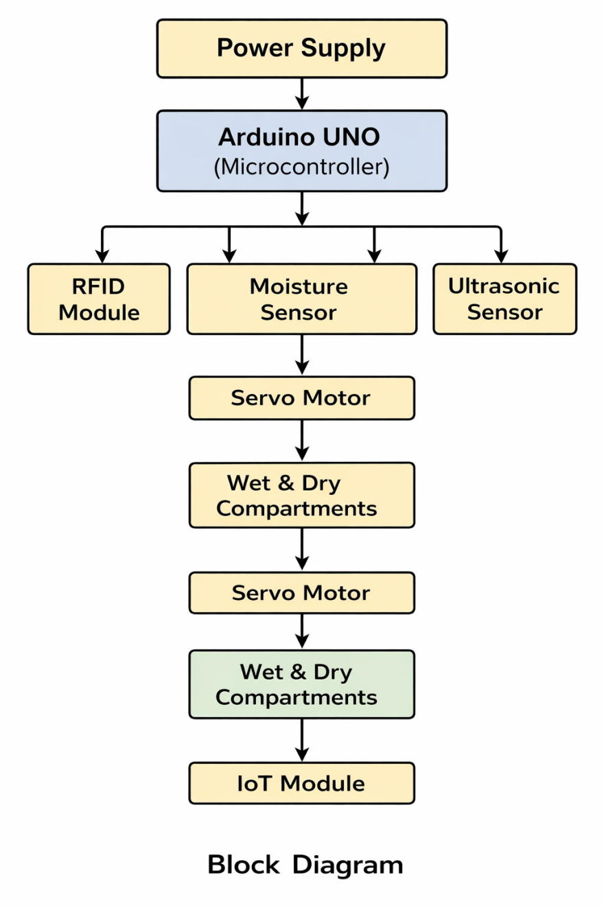
System Architecture/Proposed work Block

Slide 19
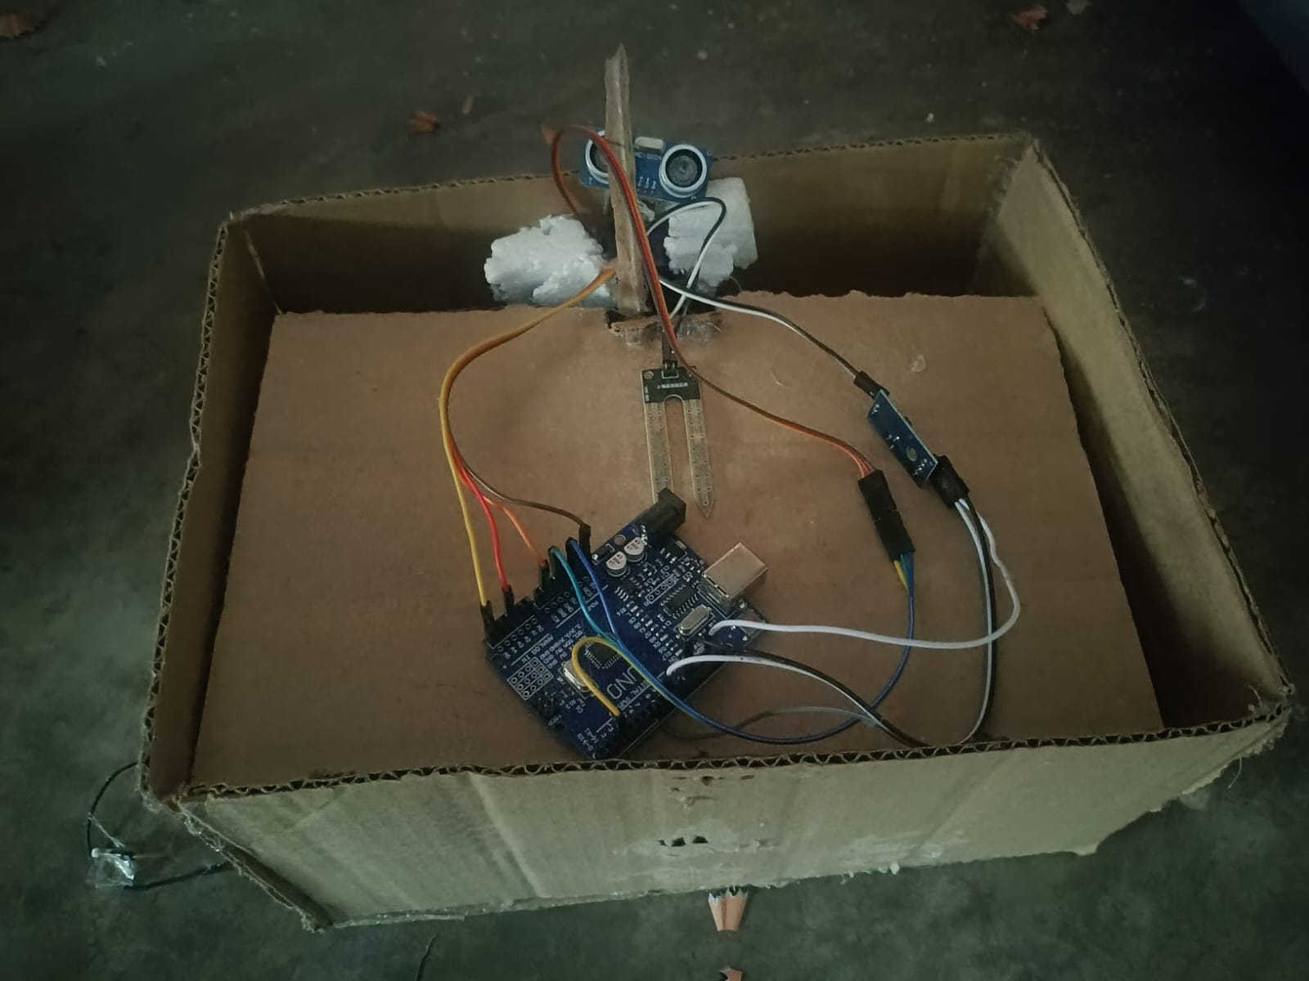
UML Diagrams (CSE & Allied)/DFD CSE & Allied / Prototype (others)

Slide 20
References (APA Style)
Arduino. (2023). Arduino Uno Rev3. https://www.arduino.cc
Blynk Inc. (2023). Blynk IoT platform. https://blynk.io
MathWorks. (2023). ThingSpeak IoT analytics platform. https://thingspeak.com
Kumar, A., & Singh, R. (2020). Smart waste management system using IoT. International Journal of Engineering Research & Technology, 9(5), 123–126.
Rao, S., & Mehta, P. (2019). Automatic garbage segregation system. International Journal of Scientific Research in Engineering and Management, 3(4), 45–49.
Sharma, M. (2021). IoT based smart dustbin monitoring system. International Journal of Innovative Technology and Exploring Engineering, 10(3), 112–116.
Verma, K. (2022). Waste segregation using machine learning techniques. Journal of Environmen

Slide 21
THANK YOU

